Slide 1

Group 3 StockPickers
Iteration 2 – Update
Presented by Serguei Chervachdize

Slide 2
Our Team
Jing Tian
Duy Nguyen
Sylvie Xiang
Serguei Chervachidze

Slide 3
Iteration 2 update overview
2 Main Areas of Focus:
Implementing features
Thorough testing of the entire product and its elements

Slide 4
Focus Area 1: Feature Implementation
Implemented forecasting with Facebook prophet (facebook.github.io)
Well suited to the use case
However, forecasting stock market is hard
Implemented saving favorites on site
Allows for saving favorite stocks
Enhances end user experience
Secure storage of API keys

Slide 5
Focus Area 2: Testing
Implemented thorough unit testing of the forecasting back end
Facebook prophet and wrapping classes
Additional unit tests in Django views
Ensuring functionality works well
Unit tests in JS on the front end
Tests for the Card class
Continued end-to-end testing of the product in Selenium

Slide 6
Next Steps
Continue comprehensive testing
Implement optional features, time permitting
Fix bugs
Finalize the product for release
Finalize and deliver all needed supporting documentation
Prepare a demo

Slide 7
Thank you
Group 3

Slide 8
Appendix

Slide 9
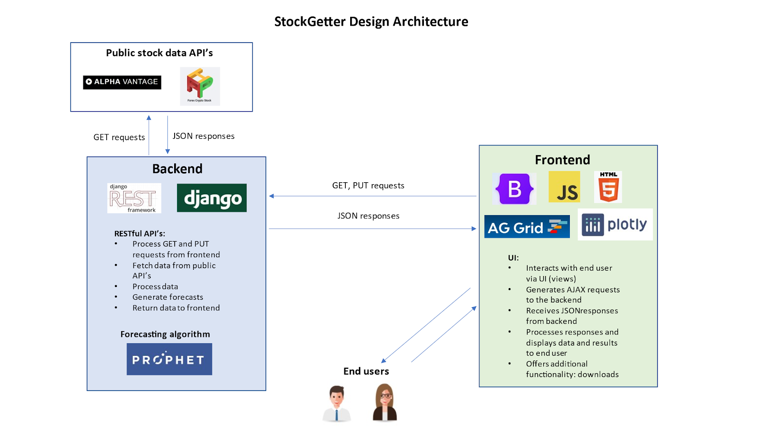
Software architecture

Slide 10
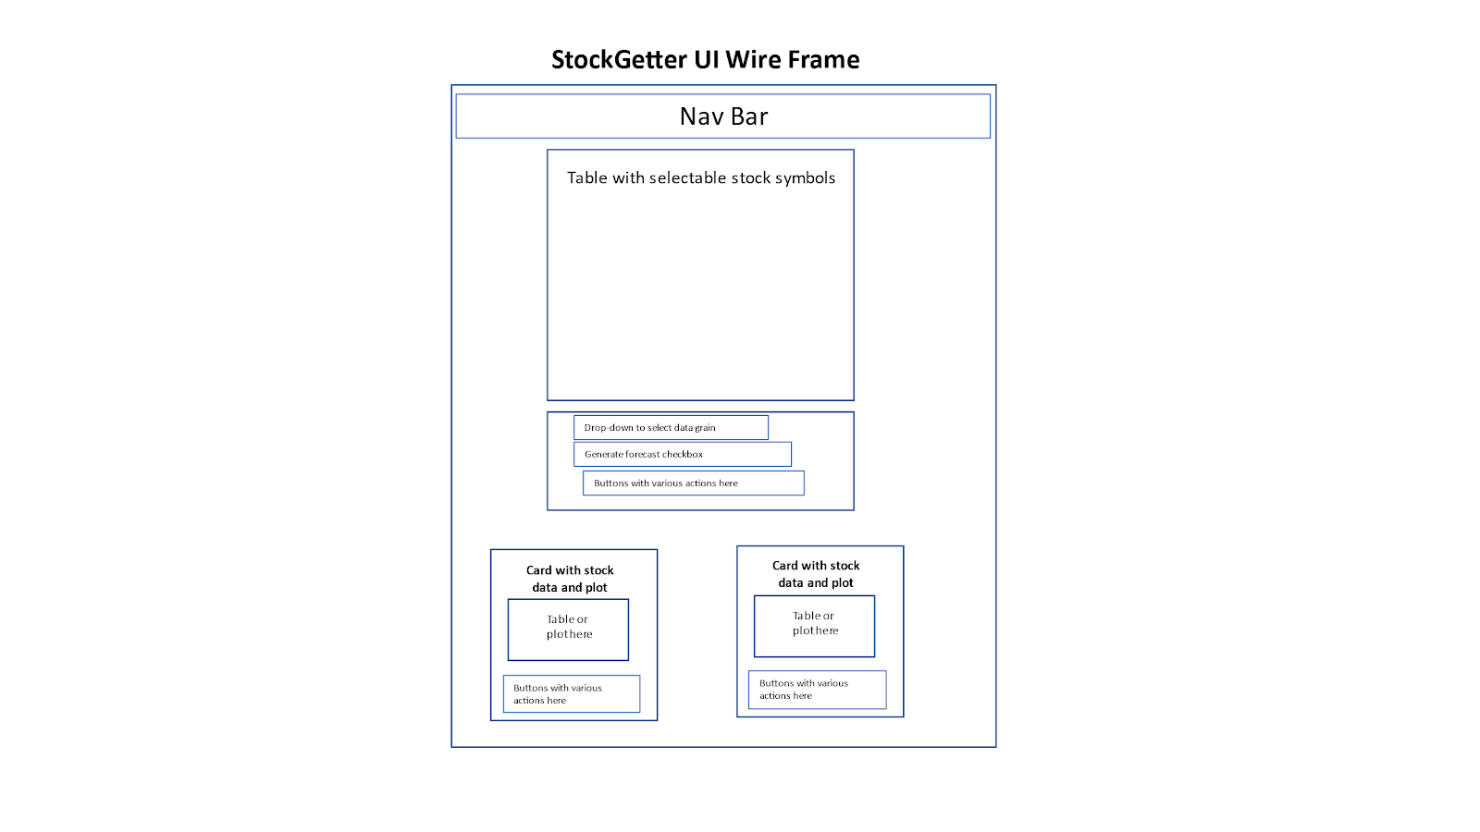
UI design

Slide 11
Security design
The product will implement robust security using the built-in Django security settings and proper practices. Specifically, the product will have the following security settings:
CORS cross-domain protections specified in the backend, allowing only the front-end to interact with the backend (and excluding all other domains)
API keys and other data stored in configuration files and loaded at runtime for each developer or deployment. These will not be committed to the repo by including these in the .gitignore file.

Slide 12
Algorithms
The key algorithm in our implementation is the Facebook Prophet ML algorithm for forecasting time series data: Prophet | Forecasting at scale. (facebook.github.io). This will be implemented on the backend, along with all necessary data pre-processing algorithms needed to interact with the prophet forecasting algorithm.

